Slide 1

Trusted Execution Environment: ARM TrustZone and IoT Security
Chaoyu Zhang
Department of Computer Science
Arkansas State University, USA
chaoyu.zhang@smail.astate.edu

Slide 2
Outline
Introduction
-Challenges and Motivation
Trust Execution Environment and TrustZone Overview
TrustZone System Architecture
-Secure Isolation Mechanism, Memory System,
-Monitor Mode, Secure Boot
TrustZone API
-Client API,
-Trusted Application and TEE API
Open-Source TEE and QEMU
SHARCS and TrustZone in SHARCS System IoT Layer
Conclusion

Slide 3







Threaten in Traditional Rich OS Application Environment
Rich OS Environment
﻿Attack surface is expanding
Malware could be hiding in the system
Vulnerability in booting process
might cause OS kernel compromise
Malware
Applications
System Libraries
Kernel / Kernel Modules
Hardware Platform
Compromised Booting

Slide 4
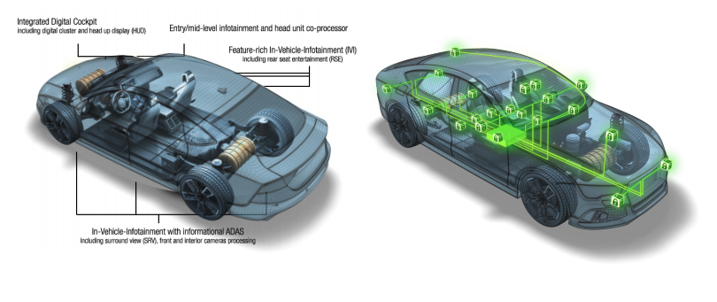
Threaten in Traditional Automotive Systems
Cars are becoming more vulnerable:
Greater computer interaction with auto sensors
Remote wireless connectivity and remote interaction
Bridges to Controller Area Network (CAN)
Attackers have the privilege of selecting where to attack
Security researchers willing to spend years on high profile attacks

Slide 5
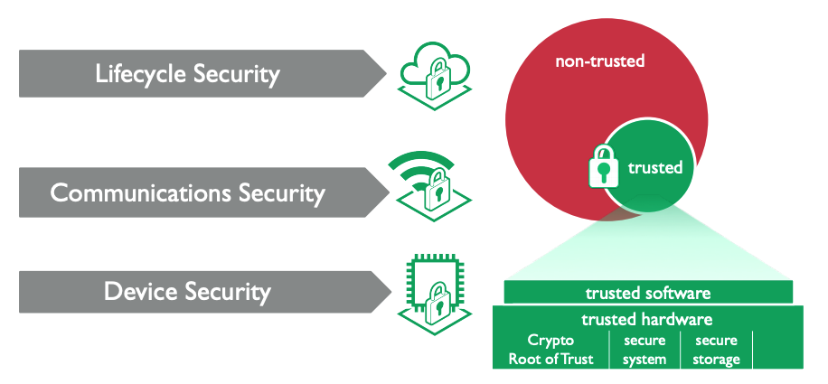
Security Requirement for Automotive Systems

Slide 6
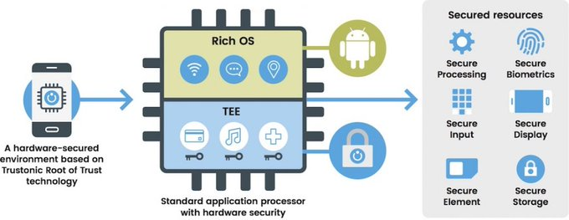
Trusted Execution Environment
TEE guarantees code and data loaded inside to be protected with respect to confidentiality, integrity and availability.
TEE is an isolated execution environment provides isolated execution, integrity of applications with confidentiality of their assets.
TEE provides a higher level of security than a rich OS(operating system) and more functionality than an ASIC based secure element.

Slide 7
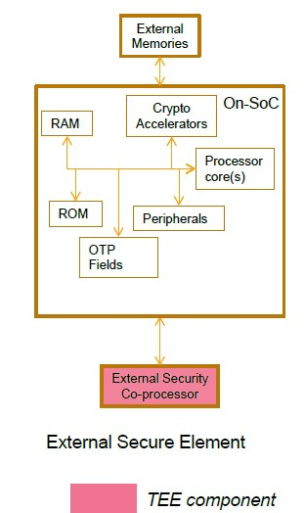
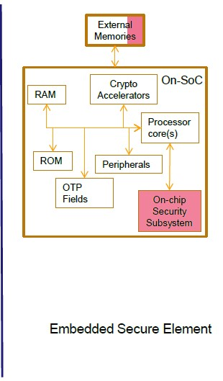
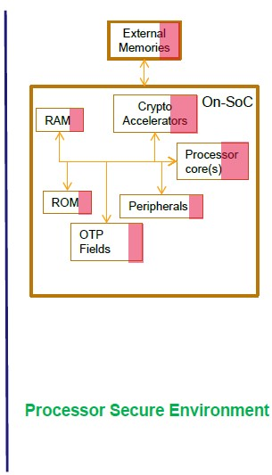
Trusted Execution Environment
TrustZone

Slide 8
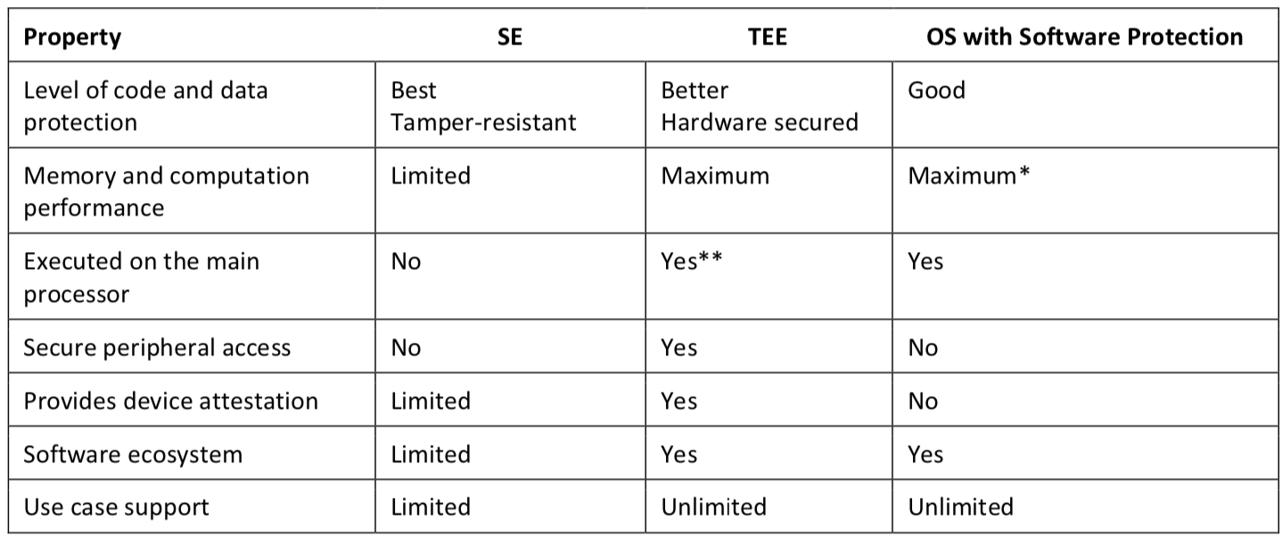
Trusted Execution Environment

Slide 9
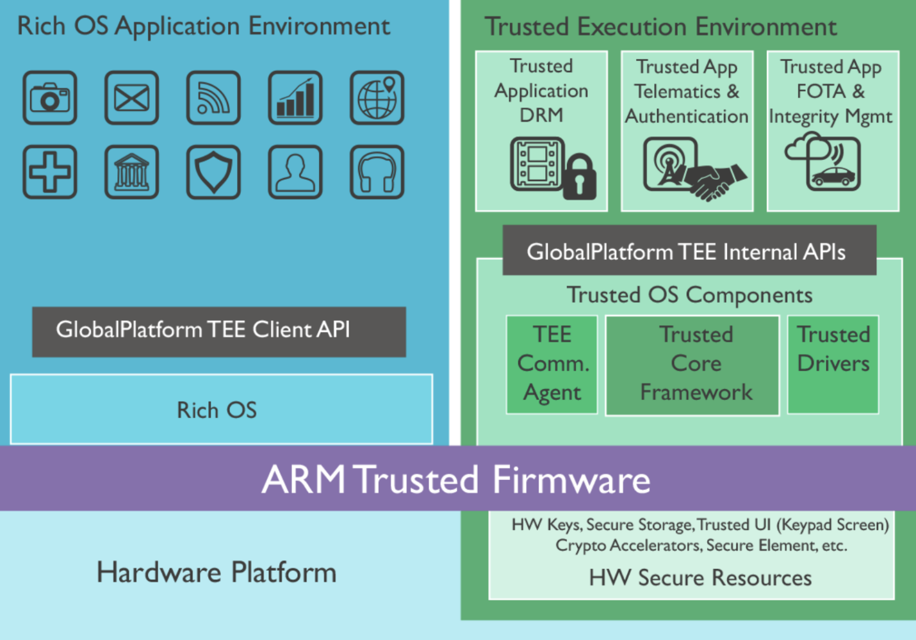
ARM TrustZone Overview
Divide SoC hardware and software resources into Secure World and Normal World.
All operations that require confidentiality are performed in the secure world.
Normal operations are in non-secure world execution, the secure world, and the non-secure world are converted through a Monitor mode
Normal world components cannot access secure world resources, secure world can access all the resource

Slide 10
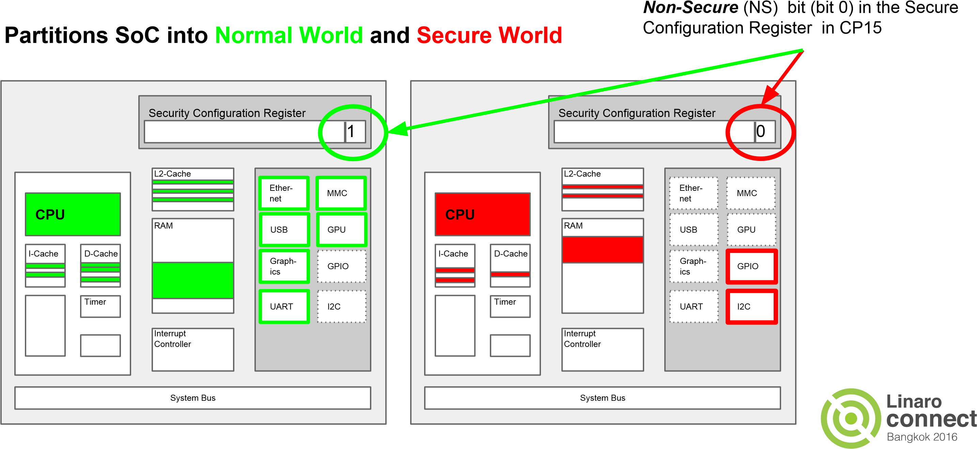
﻿ARM TrustZone Architecture
AMBA AXI bus propagates the NS bit outside the SoC
Peripherals and memory are configured during run time
TrustZone virtualizes each physical core into two cores

Slide 11
TrustZone Architecture and Mechanism
ARM Core
Interrupt Controller
AXI Bus
TZASC
TZMA
TZPC
AXI-TO-APBB
Dynamic Memory Controller
RAM
ROM
Peripherals
DRAM
Peripheral isolation mechanism
Memory isolation mechanism

Slide 12
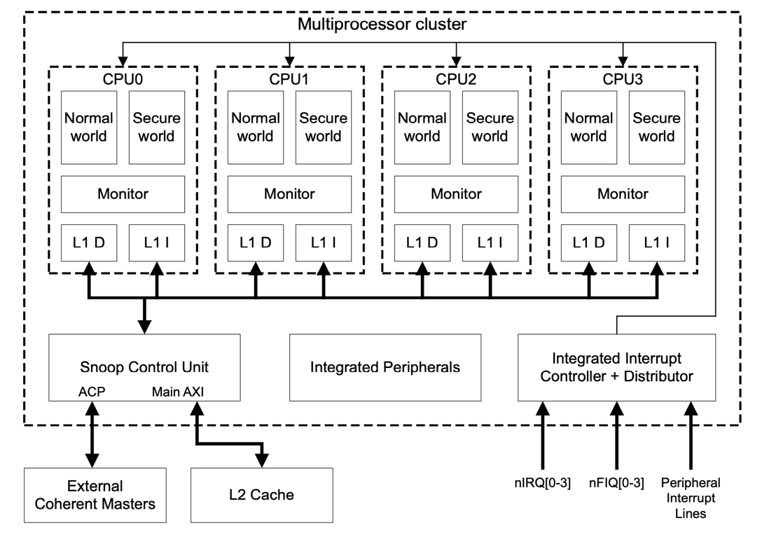
﻿TrustZone Processor Cluster Model
ARM Multiprocessor cluster has four physical cores, and each physical core has a secure virtual core and virtual non-secure core
The Non-secure virtual processor can only access Non-secure system resources, but the Secure virtual processor can see all resources
The NS bit's value on the main system bus is indirectly derived from the identity of the virtual core that performed the instruction or data access.

Slide 13
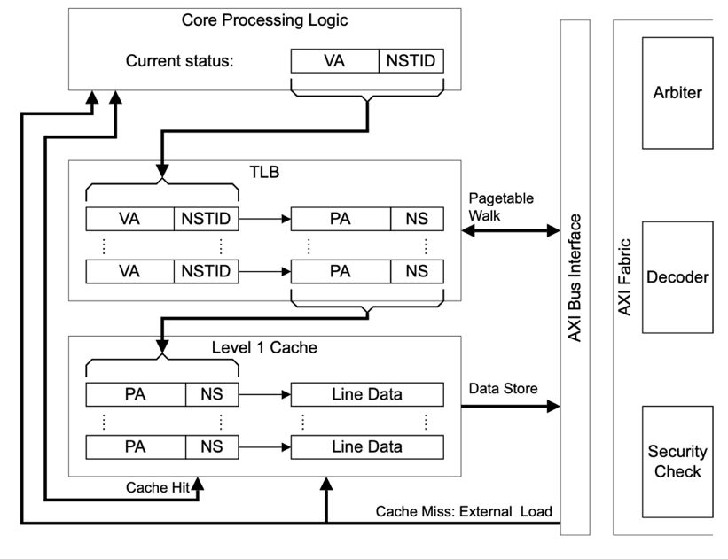
﻿TrustZone Memory System
MMU(Memory Manage Unit) maps the virtual address space to the physical address space outside of the processor.
Each world have their own virtual MMUs, manages the mapping of physical addresses.
One TLB (Translation lookaside buffer) shared by the two worlds.

Slide 14
﻿TrustZone Memory System
NS bit is to mark which world each item belongs to.
There is no need to refresh the TLB again when switching between the two worlds.
Caches has additional tag bit records the world and hold data from both sides.
There is no need to refresh the cache when switching between worlds

Slide 15
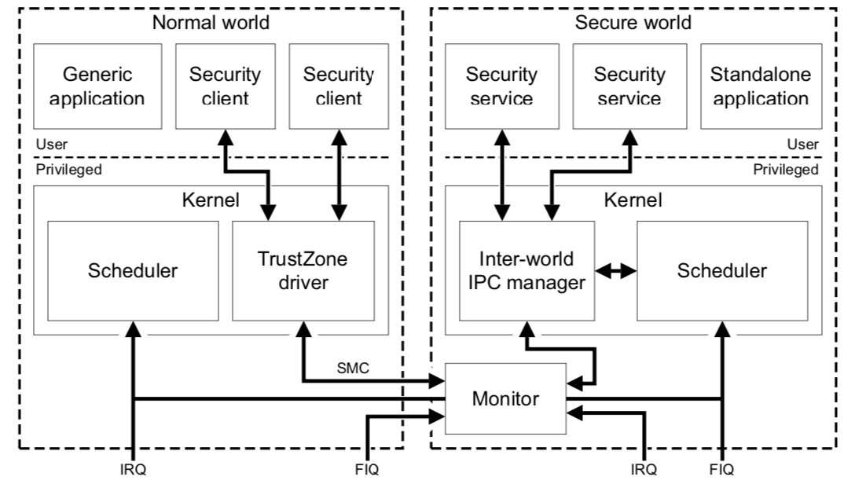
﻿TrustZone Monitor Mode
The monitor mode is a robust gatekeeper that manages the switches between the Secure and Non-secure processor states
No direct switching between the secure world and the non-secure world. All switching operations are performed through the Monitor Mode

Slide 16
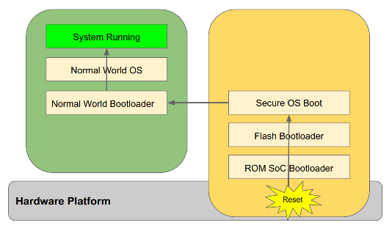
TrustZone Secure Boot
﻿Starts with trusted bootloader in ROM.
Cryptographic authenticate to each stage of the secure world boot process.
Assert the integrity of all the secure world software images that are executed. Prevent any unauthorized or maliciously modified software from running. s
﻿Public Key for the root of trust programmed into one time programmable on-chip memory.

Slide 17
﻿TrustZone API
Command
Session
Trusted Application
Client Application
TEE Internal APIs
Shared Memory
TEE Client API
Context
Trusted OS
Rich OS (REE)
Context: Connection from CA to the Trusted OS
Session: Connection from CA to the Trusted Application
Command: Unit of Communication from CA to TA
Shared Memory: Shared buffers allocated by Client API or by CA and registered

Slide 18
﻿TrustZone Client API
Principles:
Blocking functions
Can use from multiple concurrent threads in the CA
Can request cancellation
From another thread!
Client-side memory allocation
Pointers not opaque handles
Source-level portability but not binary
Implementation-specific data structures
Client API Functions (TEEC_xxx):
InitializeContext,
FinalizeContext
RegisterSharedMemory,
AllocateSharedMemory,
ReleaseSharedMemory
OpenSession, CloseSession
InvokeCommand,
RequestCancellation

Slide 19
﻿Trusted Application and TEE APIs
TEE Core API:
●
Internal Client API
Entry Points:
●
Property Access
Create
●
Cancellation Support
Destroy
●
Memory Management
Trusted Application
●
Trusted Storage
OpenSession
CloseSession
●
Time
InvokeCommand
TEE Internal APIs
●
Cryptographic
●
Arithmetical
Trusted OS
Other TEE APIs:
●
Trusted User Interface API
●
Secure Element API
●
Sockets API

Slide 20
﻿Trusted Application and TEE APIs
﻿Property Access GetPropertyAs[String, Bool, u32…] , Enumeration...
(Configuration Properties associated with TA, Client and TEE)
Cancellation Support GetCancellationFlag, MaskCancellation, UnMask...
Memory Management Malloc, Realloc, Free, MemMove...
Trusted Storage Create/Open/Close/…
TransientObject or PersistentObject
Time GetSystemTime/TAPersistentTime/REETime...
Cryptographic Cryptographic Functions: Message Digest, Symmetric Cipher, MAC, Authenticated Encryption, Asymmetric Encryption and Decryption, Key Derivation, Random Data Generation
Arithmetical Big Integer operations: Conversion, Logical, Basic Arithmetic, Modular Arithmetic...

Slide 21
﻿Trusted Application and TEE APIs
Trusted User Interface API TUICheckTextFormat,
TUIGetScreenInfo,
Create Message Box, PIN TUIInitSession/CloseSession Screen, Login Screen TUIDisplayScreen
Secure Element API Transport Level API:
SEServiceOpen, GetReaders…
Query the available Readers, SEReaderOpenSession...
Query the SEs in the SESessionOpenChannel…
Readers, SEChannelTransmit…
Exchange Data with the SEs
Service Level APIs: Discovery API, Secure Channel API
Sockets API open, close, send, recv,
error, ioctl

Slide 22
OP-TEE: an Open-Source TEE
OP-TEE is an Implementation based on TrustZone technology.
Provides a shared basis for product TEE developments. Collaboration and consolidation not reinvention.
Provides a full example for research and education. Historically hard to learn about Trusted Environments
OP-TEE implements internal core API v1.1.x，which is an API exposed to trusted applications, and TEE Client API v1.0, an API that describes how to communicate with TEE.

Slide 23

Getting Started with OP-TEE and QEMU
QEMU is a free and open-source emulator and virtualizer.
We can use QEMU v7 to simulate Armv7-A processor for OP-TEE
Fetch the
Prerequisites
$ sudo apt-get install android-tools-fastboot autoconf bison cscope curl \
flex gdisk libc6:i386 libfdt-dev libglib2.0-dev \
libpixman-1-dev libstdc++6:i386 libz1:i386 netcat \
python-crypto python-serial uuid-dev xz-utils zlib1g-dev
$ sudo apt-get install ccache
$ mkdir -p $HOME/devel/optee
Fetch the Repos
$ cd $HOME/devel/optee
$ repo init -u https://github.com/OP-TEE/manifest.git -m default.xml
$ repo sync
$ cd $HOME/devel/optee/build
$ make toolchains
$ make all run
Build and run!
Details: https://optee.readthedocs.io/en/latest/building/devices/qemu.html

Slide 24
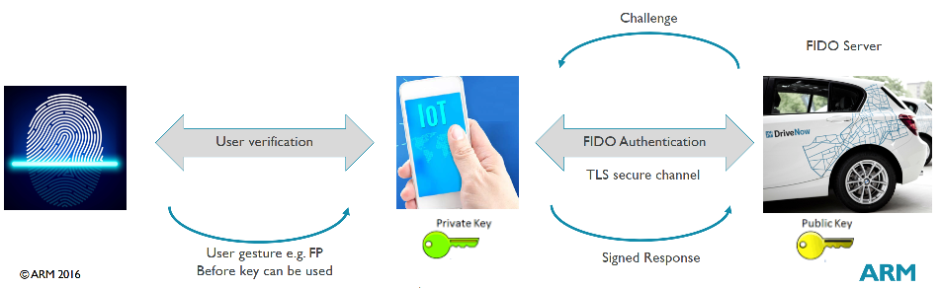
TrustZone Example
﻿Only allow authenticated users to interact
No passwords or secrets for the user
TrustZone based TEE can protect integrity/crypto on FIDO (Fast ID Online) “server” in car
TrustZone based TEE can protect private keys/crypto and FPS on phone

Slide 25




IoT Challenges Traditional Cloud Storage
Cloud Storage Server
Applications on cloud
Fog Storage System
1. Stringent Latency Requirements
2. Network Bandwidth Constraints
3. Uninterrupted Services to Cloud
IoT/Terminal Devices Disk
Applications on devices
4. Massive Distributed IoT Devices Access Control
5. Protecting Resource-Constrained Devices (big data small power)
6. Massive Distributed Devices and On-board Systems Work securely
7. Devices Compromises Without Causing Intolerable Disruptions

Slide 26

Motivation By Fog Architecture
Cloud Layer Storage Backup
OpenSSL communication
4. Decentralized access control
5. Outsourcing ABE to HPC engine with parallelization
1 & 2. Low latency and high bandwidth network, data close to computation
3. Uninterrupted services by physical controllable network
Fog Layer
Parallel
ABE
Fog Storage
Cache
OpenSSL communication
IoT/ Terminal Devices Layer
Arm-TrustZone
6. TEE and on-device cryptographic tools
7. TEE protection, multi-layer backup, devices disposable

Slide 27




SHARCS (Secure Hierarchical Adaptive Reliable Cloud Storage) system Overview
Cloud Storage layer
Untrusted Cloud
Services Provider
OpenSSL Layer
Fog Layer
HPC
Engine
Fog Storage
System
Fog
Security
Controller
OpenSSL Layer
IoT/ Terminal Devices Layer
Arm-TrustZone
IoT Devices
Compromiser

Slide 28
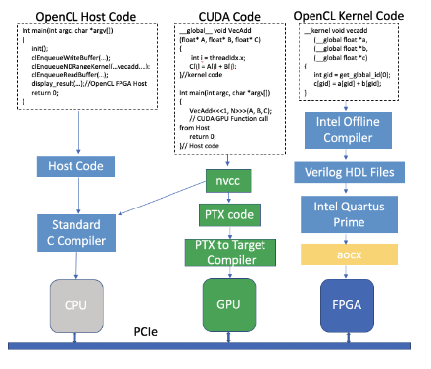
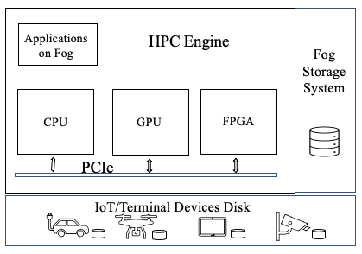
SHARCS HPC Engine

Slide 29
SHARCS Fog Security Controller
Fog Security Controller
Modular Design: change the scheme without modifying system architecture.
Scalable: for advanced security modules.
General Propose: supports basic cryptographic for security mechanism.
ABE
Symmetrical Encryption
LBE
Asymmetrical Encryption
MPC
Key Management
Homomorphic
Advanced Security
Module
Cryptographic Module
Access Control

Slide 30
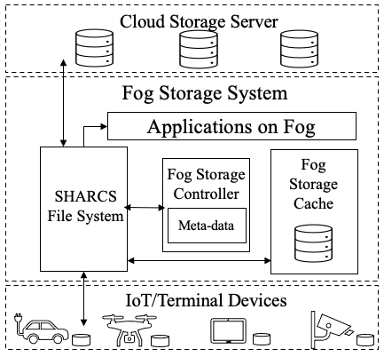
SHARCS Fog Storage System
Cloud Layer: ciphertext backup for fault-tolerance and for sharing cross different fog servers.
Fog storage caching: for massive IoT devices uninterrupted connection and real-time access.
Disk-memory-cache fashion aims to reduce the network communication overhead with low latency and high-bandwidth.
Controllability: Fog Architecture gain more controllability to achieve better security and privacy protection.

Slide 31


IoT Layer: ABE on TrustZone Implementation
Non-Secure Environment
Trusted Execution Environment
ABE
Platin
Text
ABE
User
Policy
Related Crypto
graphic
Tools
Non-Secure Applications
OP-TEE
TrustZone Client API
TrustZone Internal API
Non-Secure Rich OS
Trusted OS
ARM Trusted Firmware
Hardware Platform
Hardware Secure Resource

Slide 32
Conclusion
TrustZone offers a dependable security platform. It provides scalability and an easily deployable solution for any device that supports the TrustZone architecture.
Using the TrustZone imposes low additional limitations on speed, memory, or computing power. The TrustZone relies on the device’s original processor and memory.
We simulated the IoT group equipped with TrustZone. It provides isolated execution, the integrity of applications, and confidentiality of the assets.
Though there are challenges in creating a scalable TEE eco-system. We believe the next generation of TEE-based solutions can leverage devices' protection from multiple threats and vulnerabilities.

Slide 33
Thanks
Chaoyu Zhang
Department of Computer Science
Arkansas State University, USA
chaoyu.zhang@smail.astate.edu
33

